Slide 1

Data Structure
&
Algorithms

Slide 2
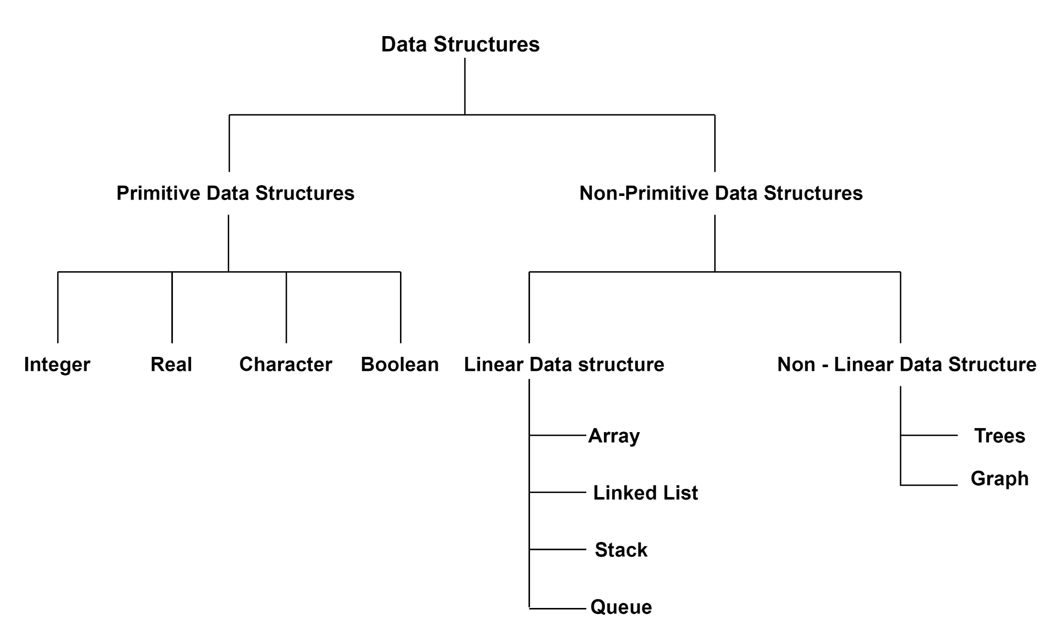
Data Structure Classification

Slide 3
Data Structure Operations
Search
Insert
Delete
Traversing
Sorting
Merging
Minimum and Maximum
Successor
Predecessor

Slide 4
Stack

Slide 5
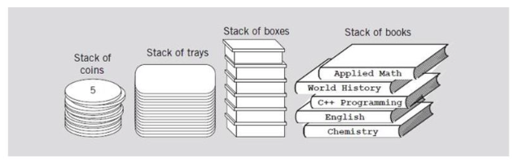
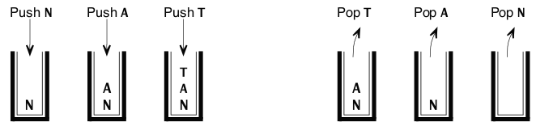
Data Structure - Stack
Input: NAT
Output: TAN

Slide 6
Stack operations
Push: Adds an element to the top of the stack.
Pop: Removes and returns the top element from the stack.
Peek: Returns the top element without removing it.
isEmpty: Checks if the stack is empty.
isFull: Checks if the stack is full (for fixed-size stacks).
Size: Returns the number of elements currently in the stack.

Slide 7
Stack - Design
Constructor
public class ArrayStack {
private double[ ] data;
private int numItems;
public ArrayStack( )
{
final int INITIAL_CAPACITY = 10;
numItems = 0;
data = new double[INITIAL_CAPACITY];
}
Size
public int size( ) {
return numItems;
}
ensureCapacity Method
public void ensureCapacity(int minimumCapacity)
{
int[] biggerArray;
if (data.length < minimumCapacity)
{
biggerArray = new double[minimumCapacity];
System.arraycopy(data, 0, biggerArray, 0, numItems);
data = biggerArray;
} }
Capacity Methods
public int getCapacity( ) {
return data.length;
}
public boolean isEmpty( ) {
return (numItems == 0);
}
Notes:
https://colab.research.google.com/drive/1g3tcEt_pIPD-liznkDytBJZfgl185ytb

Slide 8
Stack - Design
peak
public double peek( ){
if (numItems == 0)
throw new RuntimeException("Stack is Empty");
return data[numItems-1];
}
pop
public double pop( ) {
double value;
if (numItems == 0)
throw new RuntimeException("Stack is Empty");
value = data[--numItems];
return value;
}
push Method
public void push(double item) {
if (numItems == data.length) {
ensureCapacity(numItems * 2 + 1);
}
data[numItems] = item;
numItems++;
}
Notes:
https://colab.research.google.com/drive/1g3tcEt_pIPD-liznkDytBJZfgl185ytb

Slide 9

Application of Stacks
Function Call Stack: When a function is called, its context (local variables, return address) is pushed onto the call stack. When the function exits, its context is popped off, allowing the program to return to the correct place. Recursive function calls are manage using stack.
Web Browsers navigation history: Browsers use stacks to keep track of visited pages, allowing users to go back to the previous page (pop the stack) or forward (push a new page).
Data Structure Implementations: Used for traversal of data structures like graphs, and trees, particularly DFS
Game Development: In games, stacks can be used to manage different states, such as levels or menus, allowing players to navigate through them.
Dynamic Memory Allocation: Stacks are used to manage memory allocation for local variables. When a function exits, its stack frame is released automatically.
Image URL

Slide 10
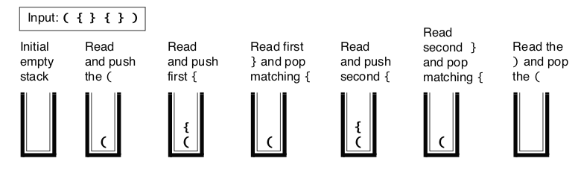
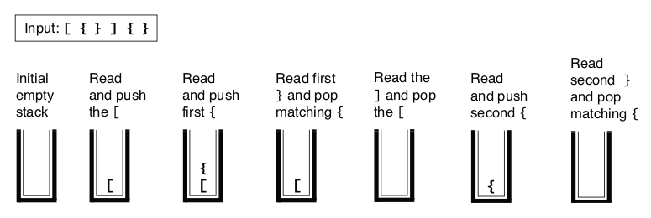
Validating Expressions using Stack

Slide 11
Stack - Expression Validation Design
public static boolean isBalanced(String expression) {
final char LEFT_NORMAL = '(';
final char RIGHT_NORMAL = ')';
final char LEFT_CURLY = '{';
final char RIGHT_CURLY = '}';
final char LEFT_SQUARE = '[';
final char RIGHT_SQUARE = ']';
ArrayStack store = new ArrayStack();
boolean failed = false;
for (int i = 0; !failed && (i < expression.length()); i++) {
switch (expression.charAt(i)) {
case LEFT_NORMAL: case LEFT_CURLY: case LEFT_SQUARE:
store.push(expression.charAt(i));
break;
case RIGHT_NORMAL:
if (store.isEmpty( ) || (store.pop( ) != LEFT_NORMAL))
failed = true;
break;
case RIGHT_CURLY:
if (store.isEmpty( ) || (store.pop( ) != LEFT_CURLY))
failed = true;
break;
case RIGHT_SQUARE:
if (store.isEmpty( ) || (store.pop( ) != LEFT_SQUARE))
failed = true;
break;
}
}
return (store.isEmpty( ) && !failed);
}

Slide 12
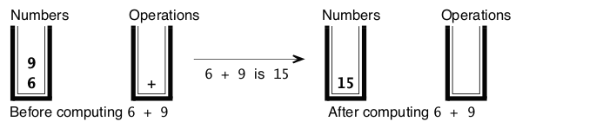
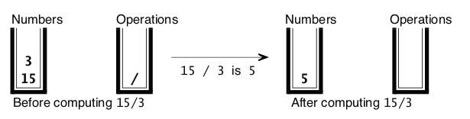
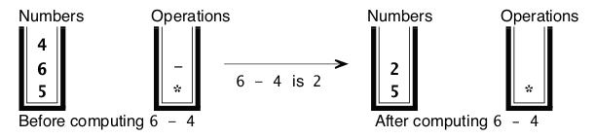
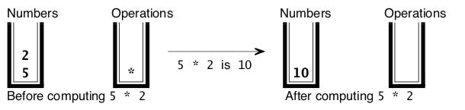
Arithmetic Expressions using Stack
(((6 + 9) / 3) * (6 - 4))

Slide 13
Stack - Arithmetic Expression Evaluation Design
public static final Pattern CHARACTER = Pattern.compile("\\S.*?");
public static final Pattern UNSIGNED_DOUBLE = Pattern.compile("((\\d+\\.?\\d*)|(\\.\\d+))([Ee][-+]?\\d+)?.*?");
public static double evaluate(String expression) {
ArrayStack numbers = new ArrayStack( ); ArrayStack operations = new ArrayStack( ); Scanner input = new Scanner(expression); String next;
while (input.hasNext( )) {
if (input.hasNext(UNSIGNED_DOUBLE)) {
next = input.findInLine(UNSIGNED_DOUBLE);
numbers.push(Double.parseDouble(next));
}
else {
next = input.findInLine(CHARACTER);
switch (next.charAt(0)) {
case '+': // Addition case '-': // Subtraction case '*': // Multiplication case '/': // Division
operations.push(next.charAt(0)); break;
case ')': // Right parenthesis (the evaluateStackTops function is on the next page)
evaluateStackTops(numbers, operations); break;
case '(': // Left parenthesis
break;
default : // Illegal character throw new IllegalArgumentException("Illegal character >"+next.charAt(0)+"<");
} } }
if (numbers.size( ) != 1) throw new IllegalArgumentException("Illegal input expression");
return numbers.pop( );
}

Slide 14
Stack - Arithmetic Expression Evaluation Design
public static void evaluateStackTops(ArrayStack numbers, ArrayStack operations) {
double operand1, operand2;
// Check that the stacks have enough items, and get the two operands.
if ((numbers.size( ) < 2) || (operations.isEmpty( )))
throw new IllegalArgumentException("Illegal expression");
operand2 = numbers.pop( );
operand1 = numbers.pop( );
// Carry out an action based on the operation on the top of the stack.
char operator = (char) operations.pop( );
switch (operator) {
case '+': numbers.push(operand1 + operand2);
break;
case '-': numbers.push(operand1 - operand2);
break;
case '*': numbers.push(operand1 * operand2);
break;
case '/':
numbers.push(operand1 / operand2);
break;
default : throw new IllegalArgumentException("Illegal operation");
}
}

Slide 15
Algorithm to convert Infix to Postfix and Prefix
Infix: A + B * C
Step 1: Reverse the Infix Expression
Reverse the expression: C * B + A
Swap parentheses (if any). Since there are none in this example, the expression remains C * B + A.
Step 2: Convert the Reversed Expression to Postfix
We now have the reversed expression: C * B + A.
Rules for Converting Infix to Postfix:
Operands (e.g., A, B, C) are added directly to the postfix expression.
Operators (+, *) are pushed onto the stack. Pop and append operators to the postfix expression based on precedence and associativity.
Parentheses: Push ( onto the stack and pop operators until ) is encountered.

Slide 16
Conversion Process:
Read C: It's an operand, so add it to the postfix expression.
Postfix: C
Read *: Push it onto the stack (it's an operator).
Stack: *
Read B: It's an operand, so add it to the postfix expression.
Postfix: C B
Read +: Compare precedence with * in the stack. Since + has lower precedence than *, pop * from the stack and add to the postfix expression. Then push + onto the stack.
Postfix: C B *
Stack: +
Read A: It's an operand, so add it to the postfix expression.
Postfix: C B * A
End of Expression: Pop all remaining operators from the stack and add to the postfix expression.
Postfix: C B * A +
Step 3: Reverse the Postfix Expression
Reverse the resulting postfix expression C B * A +:
Reversed Postfix (which is the Prefix): + A * B C
Final Prefix Expression
Prefix: + A * B C

Slide 17
Stack Assignment
Postfix
7 3 5 * + 4 –
(7 + (3 * 5)) – 4
Prefix
(2 + 3) * 7
* + 2 3 7

Slide 18
Infix | Postfix | Prefix
A + B * C | A B C * + | + A * B C
A * (B + C) / D | A B C + * D / | / * A + B C D
A + B * (C - D) | A B C D - * + | + A * B - C D
(A + B) * (C - D) | (A + B) * (C - D) | * + A B - C D
A * (B + C) - D / E | A B C + * D E / - | - * A + B C / D E

Slide 19
Queue

Slide 20

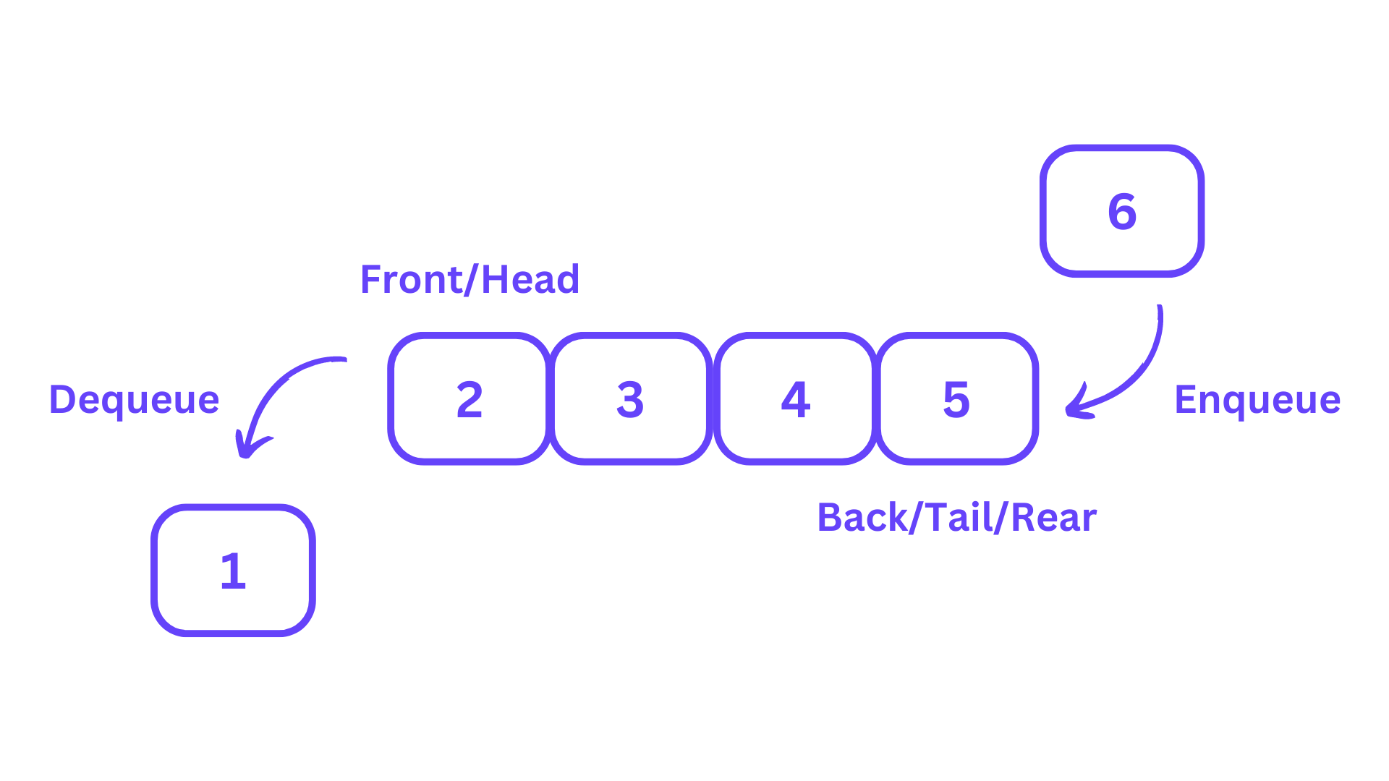
Data Structure - Queue
8
[0] [1] [2] [3] [4]
[0] [1] [2] [3] [4]
head=-1 tail=-1
head=0 tail=0
Empty queue
One element added to queue
8
2
5
2
5
[0] [1] [2] [3] [4]
[0] [1] [2] [3] [4]
head=0 tail=2
head=1 tail=2
Two elements added to queue
One element deleted from queue
2
5
4
3
3
[0] [1] [2] [3] [4]
[0] [1] [2] [3] [4]
head=1 tail=4
head=4 tail=4
Two elements added to queue
Three elements deleted from queue

Slide 21
Queue operations
Enqueue: Adds an element to the rear of the queue.
Dequeue: Removes and returns the element from the front of the queue.
Peek / Front: Returns the front element without removing it.
isEmpty: Checks if the queue is empty.
isFull: Checks if the queue is full (for fixed-size queues).
Size: Returns the number of elements currently in the queue.
Animation URL

Slide 22
Queue - Design
Constructor and internal variables
public class ArrayQueue {
private double[ ] data;
private int numItems;
private int head = -1;
private int tail = -1;
public ArrayQueue( ) {
final int INITIAL_CAPACITY = 5;
numItems = 0;
data = new double[INITIAL_CAPACITY];
}
Add method
public void add(double item) {
if (numItems == data.length)
{
ensureCapacity(numItems*2 + 1);
}
if (numItems == 0)
{
head = 0;
tail = 0;
}
else
tail = nextIndex(tail);
data[tail] = item;
numItems++;
}

Slide 23
Queue - Design
ensureCapacity method
public void ensureCapacity(int minimumCapacity) {
double[ ] biggerArray;
int n1, n2;
if (data.length >= minimumCapacity) {
// No change needed.
return;
}
else if (numItems == 0) {
// Just increase the size of the array because the queue is empty.
data = new double[minimumCapacity];
}
else if (head <= tail) {
// Create larger array and copy data[head] ... data[tail] into it.
biggerArray = new double[minimumCapacity];
System.arraycopy(data, head, biggerArray, head, numItems);
data = biggerArray;
}
else {
// Handle two segments
// Head to end of the array
// zero index to tail
biggerArray = new double[minimumCapacity];
n1 = data.length - head;
n2 = tail + 1;
System.arraycopy(data, head, biggerArray, 0, n1);
System.arraycopy(data, 0, biggerArray, n1, n2);
head = 0;
tail = numItems-1;
data = biggerArray;
}
}

Slide 24
Queue - Design
size methods
public int getCapacity( ) {
return data.length;
}
public boolean isEmpty( ) {
return (numItems == 0);
}
private int nextIndex(int i) {
if (++i == data.length) {
return 0;
}
else {
return i;
}
}
public int size( ) {
return numItems;
}
Remove method
public double remove( ) {
double answer;
if (numItems == 0)
throw new RuntimeException("Queue underflow.");
answer = data[head];
data[head] = 0;
head = nextIndex(head);
numItems--;
return answer;
}
public String toString(){
return "Array: "+java.util.Arrays.toString(data)+" head:"+head+" tail:"+tail;
}

Slide 25
Queue Applications
Schedule jobs and execute in the correct order.
Print jobs that are sent to the printer.
Breadth-first search algorithm.
Manage incoming calls or chat requests and handle in the correct order.
Manage the order in which processes are executed on the CPU.
Buffering data during data transfer
Buffering while playing music
Add a song at the end of the playlist
First Come First Serve(FCFS) algorithms

Slide 26
Double-Ended Queue - Deque
Dequeue is short from double ended queue
Entries can be inserted and removed from both ends
We can implement dequeue using java.util.Deque
We can use dequeue to perform both stack and queue operations
Operation | At the front end | At the back end
Adding an element | push(element) addFirst(element) | add(element) addLast(element)
remove an element and return a reference to the removed element | remove() removeFirst() pop() | removeLast()
retrieve an element without removing it | peek peekFirst() | peekLast()

Slide 27
Priority Queue
Assign priority to the item
Sample Use cases
Hospital Emergency
Computer processes
Example
Rahul Sharma, priority 0
Ashok Ranjan, priority 3
Geeta Goel, priority 2
Tim David, priority 3
Ram Patel, priority 2
Design
public class PriorityQueue<E> {
private ArrayQueue<E>[ ] queues
queues[3] : Ashok Ranjan (at the front) followed by Tim David
queues[2] : Geeta Goel (at the front) followed by Ram Patel
queues[1] : empty
queues[0] : Rahul Sharma

Slide 28
Quiz

Slide 29
Which of the following data structures is most suitable for implementing a recursive algorithm?
A. Queue
B. Array
C. Stack
D. Linked List
Answer: C

Slide 30
Given the following sequence of operations on a stack: push(1), push(2), pop(), push(3), push(4), pop(). What is the top element of the stack after these operations?
A. 3
B. 2
C. 1
D. 4
Answer: A

Slide 31
Which data structure is used in the implementation of function calls in programming languages?
A. Queue
B. Stack
C. Array
D. Binary Tree
Answer: B

Slide 32
Which of the following is not an application of a queue?
A. CPU Scheduling
B. Memory Management
C. Function Call Management
D. Disk Scheduling
Answer: C

Slide 33
Questions

